Slide 1
Software system design and implementation
LIBRARY
MANAGEMENT
SYSTEM
Vamsee Chilukuri
Greeshma Palanki
Naveena Surakanti
Hari Srinivas Kothuri

Slide 2
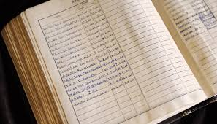
Goals and domain
The purpose of the Library Management System is to automate the pre-existing manual book entry system with the help of computerized equipment. So that their valuable data/information can be stored for a longer period with easily accessing and manipulating the same.
The Smart library management system is a web application which makes easy for both the librarian and users to effectively manage the library data.
The users can view available books, submit feedback, create account. Librarian can effectively manage the student and books records in digital format and can perform all the generic operations of the library.

Slide 3
Users and their needs
Librarian
Need to issue/return and manage the books
Need to modify the books related information
Has to generate the reports and search for the books and members of the library
Need to update their profile
Has to send remainder notifications for the users to return the books.
User
Want to view the books that are available in the library
Need to update their profile
Track the status of the borrowed books
Submit queries or suggestions related to books or library management.

Slide 4
REQUIREMENTS
FUNCTIONAL REQUIREMENTS
Members should be able to create or log in. Librarian should have access to privilege functions after authentication.
Catalog management
Search and filtering
User management
Communication – users and librarians can provide their suggestions and queries.
NON-FUNCTIONAL REQUIREMENTS
The system should respond quickly to user queries and transactions even during peak usage.
The system should be reliable with minimal downtime and the data including personal information and borrowing history must be protected.
The system have an intuitive and user-friendly interface for members and librarians.

Slide 5
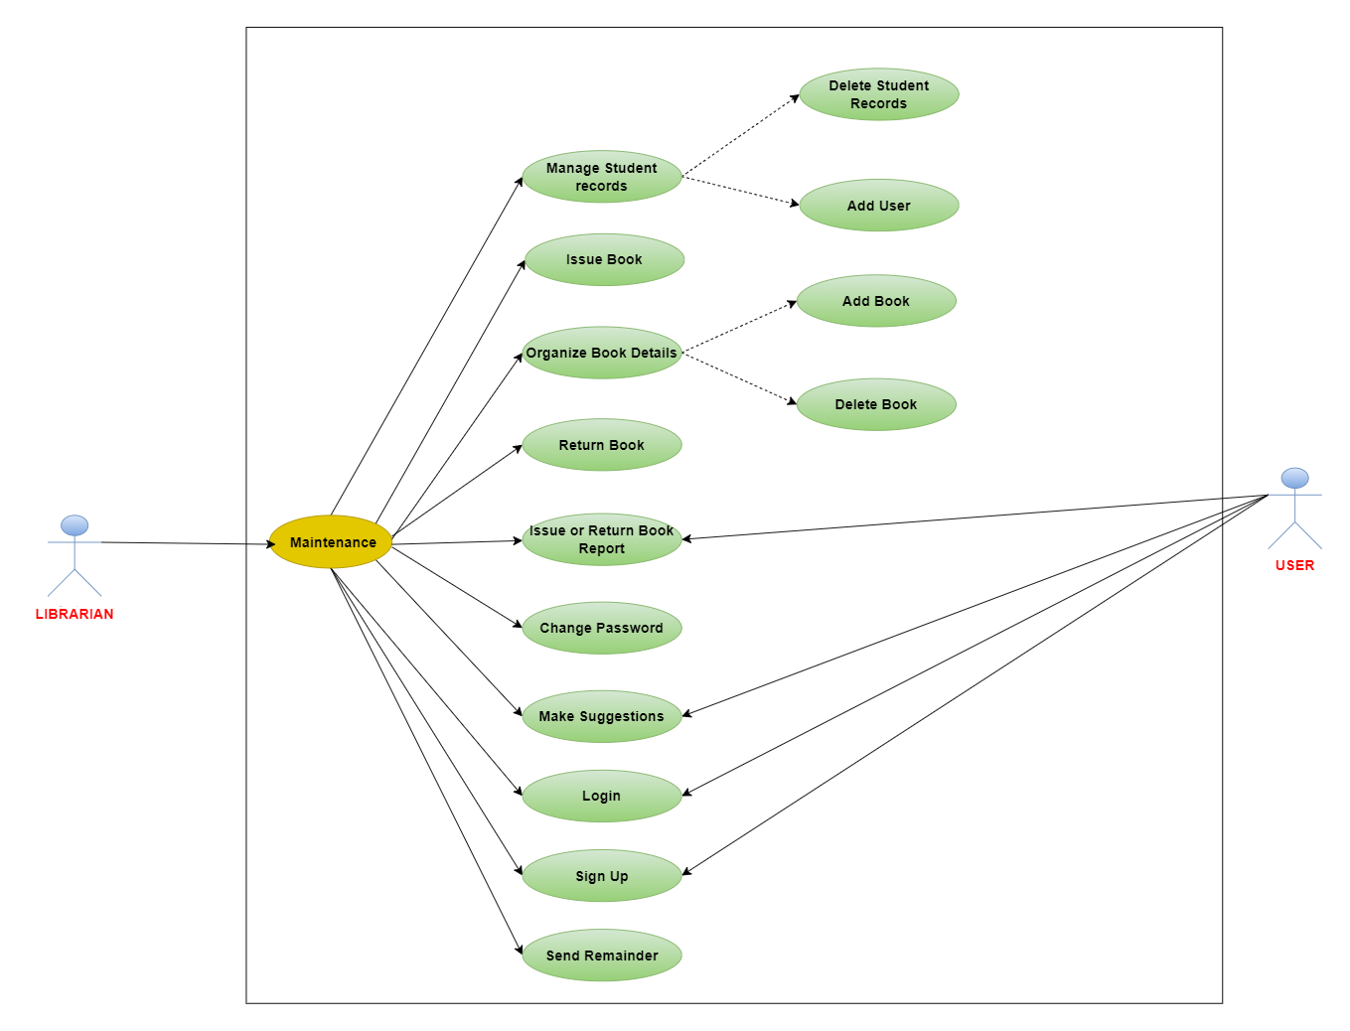
Use Case Diagram

Slide 6
TECHNICAL STACK
HTML 5
JAVA SCRIPT
CSS
PHP
MY SQL
XAMPP (APPLICATION - TO HOST THE BACKEND)

Slide 7
BENIFITS
Efficient Book Transaction Management (Issue and Return)
Organized Book details and Availability
Enhanced User experience with Feedback Mechanism
Data Security and Password management
Customizable Reporting and Analytics.

Slide 8
DEMO

Slide 9


